Slide 1

Testing and Debugging, and Backwards Compatibility
Android Developer Fundamentals
Lesson 3
This work is licensed under a Creative Commons Attribution-NonCommercial 4.0 International License
Android Developer Fundamentals

Slide 2
3.2 Testing Your App
This work is licensed under a Creative Commons Attribution-NonCommercial 4.0 International License
Android Developer Fundamentals
Testing your app

Slide 3
Contents
Why testing is worth your time
Unit testing
Note: User interface testing (instrumented testing) is covered in a later chapter

Slide 4
Testing Rocks

Slide 5

Why should you test your app?
Find and fix issues early
Less costly
Takes less effort
Costs to fix bugs increases with time
Cost to Fix
Catch bugs early!
$1000
$100
$10
$1
Specification
Design
Code
QA
Release
Discovery Time

Slide 6
Types of testing
Levels of Testing
Component, integration, protocol, system
Types of Testing
Installation, compatibility, regression, acceptance
Performance, scalability, usability, security
User interface and interaction tests
Automated UI testing tools
Instrumented testing (covered later)

Slide 7
Test-Driven Development (TDD)
Define a test case for a requirement
Write tests that assert all conditions of the test case
Write code against the test
Iterate on and refactor code until it passes the test
Repeat until all requirements have test cases, all tests pass, and all functionality has been implemented

Slide 8
Tests in your project
Android Studio creates three source sets for your project
main—code and resources
test—local unit tests
androidTest—instrumented tests

Slide 9
Local Unit Tests

Slide 10
Unit tests
Smallest testable parts of your program
Isolate each component and demonstrate the individual parts are correct
Java Method tests
Results
Inputs
Java method
Graceful Failure

Slide 11
Local unit tests in JUnit
Compiled and run entirely on your local machine with the Java Virtual Machine (JVM)
Use to test the parts of your app (such as the internal logic) that do not need access to the Android framework or an Android device or emulator, or those for which you can create fake (mock) objects that pretend to behave like the framework equivalents
Unit tests are written with JUnit, a common unit testing framework for Java.

Slide 12
Local unit tests in your project
Tests are in the same package as the associated application class.
Only org.junit imported - no Android classes
Project path for test classes: .../module-name/src/test/java/

Slide 13
Imports for JUnit
// Annotations
import org.junit.Before;
import org.junit.Test;
import org.junit.runner.RunWith;
// Basic JUnit4 test runner
import org.junit.runners.JUnit4;
// assertThat method
import static org.junit.Assert.assertThat;

Slide 14
Testing class
/**
* JUnit4 unit tests for the calculator logic.
* These are local unit tests; no device needed
*/
@RunWith(JUnit4.class) // Specify the test runner
public class CalculatorTest { // Name it what you are testing
}

Slide 15
ExampleTest
/
**
* Test for simple addition.
* Each test is identified by a @Test annotation.
*/
@Test
public void addTwoNumbers() {
double resultAdd = mCalculator.add(1d, 1d);
assertThat(resultAdd, is(equalTo(2d)));
}

Slide 16
@Test Annotation
Tells JUnit this method is a test method (JUnit 4)
Information to the test runner
Not necessary anymore to prefix test methods with "test"

Slide 17
setUp() method
/**
* Set up the environment for testing
*/
@Before
public void setUp() {
mCalculator = new Calculator();
}
Sets up environment for testing
Initialize variables and objects used in multiple tests

Slide 18
tearDown() method
/**
* Release external resources
*/
@After
public void tearDown() {
....
}
Frees resources

Slide 19
Running Tests in Android Studio

Slide 20

Starting a test run
Right-click test class and select Run 'app_name' test
Right-click test package and select Run tests in 'package'

Slide 21
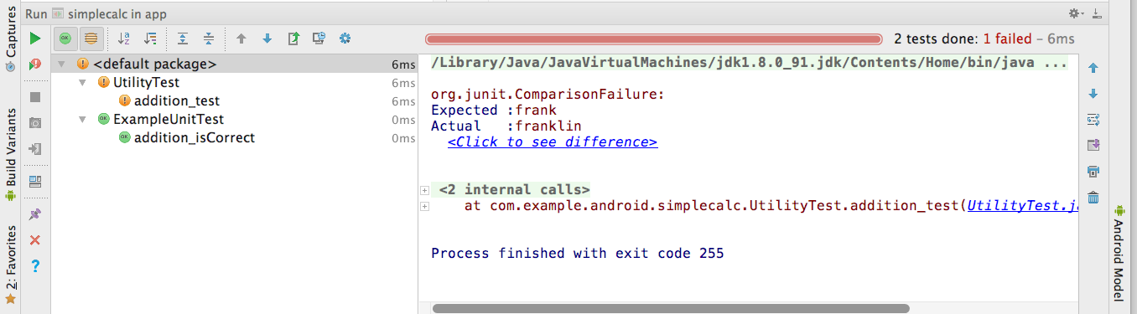
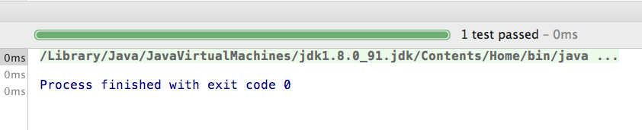
Passing and failing
Fail
Fail
Pass
Result details
Pass

Slide 22
Testing Floating Point Results

Slide 23
Testing Floating Point
Be careful with floating point tests
Recall from basic computer science:
Floating point arithmetic is not accurate in binary

Slide 24
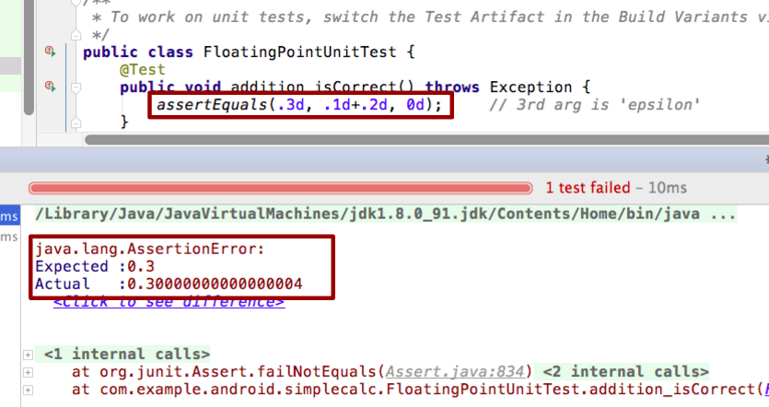
Test fails with floating point numbers

Slide 25
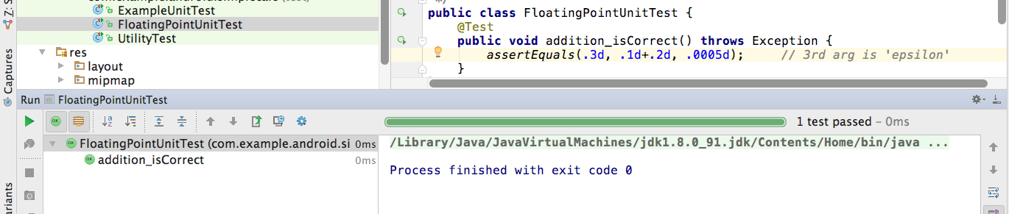
Fix test with floating point numbers
They are the same within .0005 in this test

Slide 26
Learn more
Getting Started with Testing
Best Practices for Testing
Building Local Unit Tests
JUnit 4 Home Page
JUnit 4 API Reference
Android Testing Codelab
Android Tools Protip: Test Size Annotations
Android Testing Support - Testing Patterns (video)

Slide 27
What's Next?
Concept Chapter: 3.2 C Testing Your App
Practical: 3.2 P Testing Apps with Unit Tests

Slide 28
END

